Slide 1
Health Mitra
-Making Lives Smile

Slide 2
Introduction:-
Health Mitra is an online platform offering personalized diet and nutrition plans based on BMI.
Our mission is to empower users with accurate, customized guidance from expert nutritionists and healthcare professionals.
With a user-friendly interface and advanced technology, we help individuals achieve their health goals by promoting proper nutrition and healthy lifestyle choices.
We are dedicated to providing accurate, evidence-based recommendations, guided by a team of experienced nutritionists and healthcare experts.

Slide 3
Objective:-
Objective: To introduce a comprehensive health advisor website with a BMI calculator to promote health awareness and facilitate informed decision-making.
Goals:
Provide a user-friendly platform for calculating BMI accurately.
Offer personalized health advice based on BMI results.
Educate users about the importance of maintaining a healthy BMI.

Slide 4
Need:-
Accessibility of reliable information
Serves as an educational platform
Empowerment:By providing up to date information
Support of community
Support of community
Global reach
Emergency preparedness

Slide 5
Motivation-
Inspiring Behaviour change : motivate user to adopt healthier behaviour s and lifestyle
Goal Setting and Tracking: Many health websites allow users to set specific health goals and track their progress over time
Social Support and Accountability
Experts guidance and support

Slide 6
Literature Survey:-
SR.NO | NAME OF THE AUTHORS | TITLE ANDYEAR OF PUBLICATION | SYNOPSIS
1 | 1)HAMID MAGHADASSI 2) REZA RABIEI 3) FARKHONDESH ASADI | QUALITY OF HEALTH WEBSITES AND THEIR INFLUENCE PERCEIVED USEFULLNESS MARCH 2017 | The countries like UK,USA and Australia have developed some guidelines for desining such websites Regular updates Reliable
2 | 1)MOHHAMAD SAAD 2)ASHRAF ZIA 3)MAHWISH KUNDI 4)MOHHAMAD HALEEM | HEALTH WEBSITES VISUAL STRUCTURE: THE NECESSITY OF DEVELOPING COMPREHENSIVE DESIGN GUIDELINE 25 JULY 2022 | Accesssible on any devices Simple and attractive Accurate information Privacy and security User friendly design
3 | 1)SUBHASH CHANDRA MAJHI 2)Dr. RAJESH DAS | A CONTENT ANALYSIS OF WEBSITES OF INDIAN MEDICAL RESEARCH INSTITUTIONS IN RESPECT TO LIBRARY SERVICES IN COVID-19 JANUARY 2022 | Library websites of the medical research institute of India. Articles on the websites Knowledge increasing statement

Slide 7
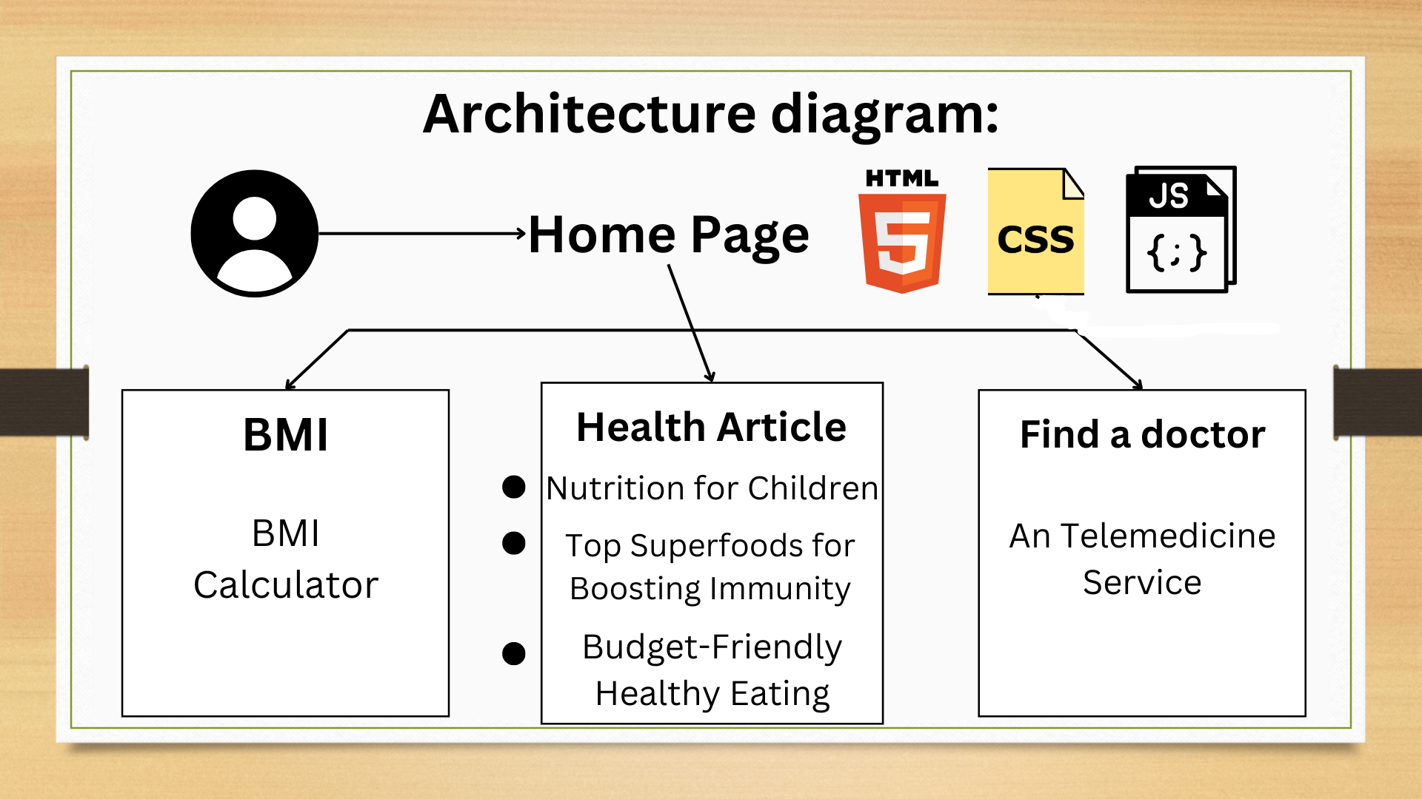
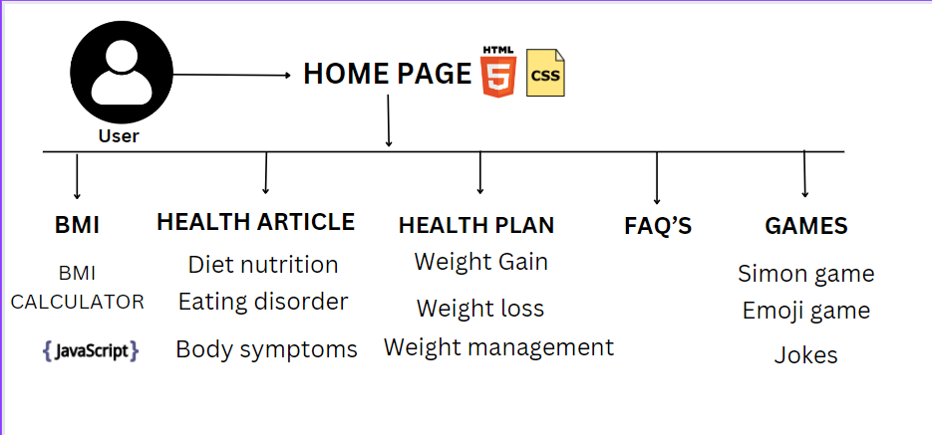
Architecture diagram:-

Slide 8
Algorithmic Approach:-
The programming languages used for website are HTML, CSS and java script. HTML is used to create basic units of the website like login, health plan, health article, jobs, support, FAQ’s(frequently asked questions), privacy policy and contact us. CSS(cascading style sheets) is used to style the home page, BMI and login page using background image, font styles etc. Java script is used to create BMI calculator, which calculates BMI on the basis of height (in cm) and Weight(in Kg) entered. There are three categories created on the basis BMI inputs: • Underweight(BMI<18.5)
• Normal Weight(BMI<25) • Overweight(25<BMI<30) • Obese(BMI>30) These categories are formed using if else loop. Login page is created to have an user interactive interface. By clicking on health plan section we can access the BMI page. BMI page is linked to health plan page using anchor tag in HTML.

Slide 9


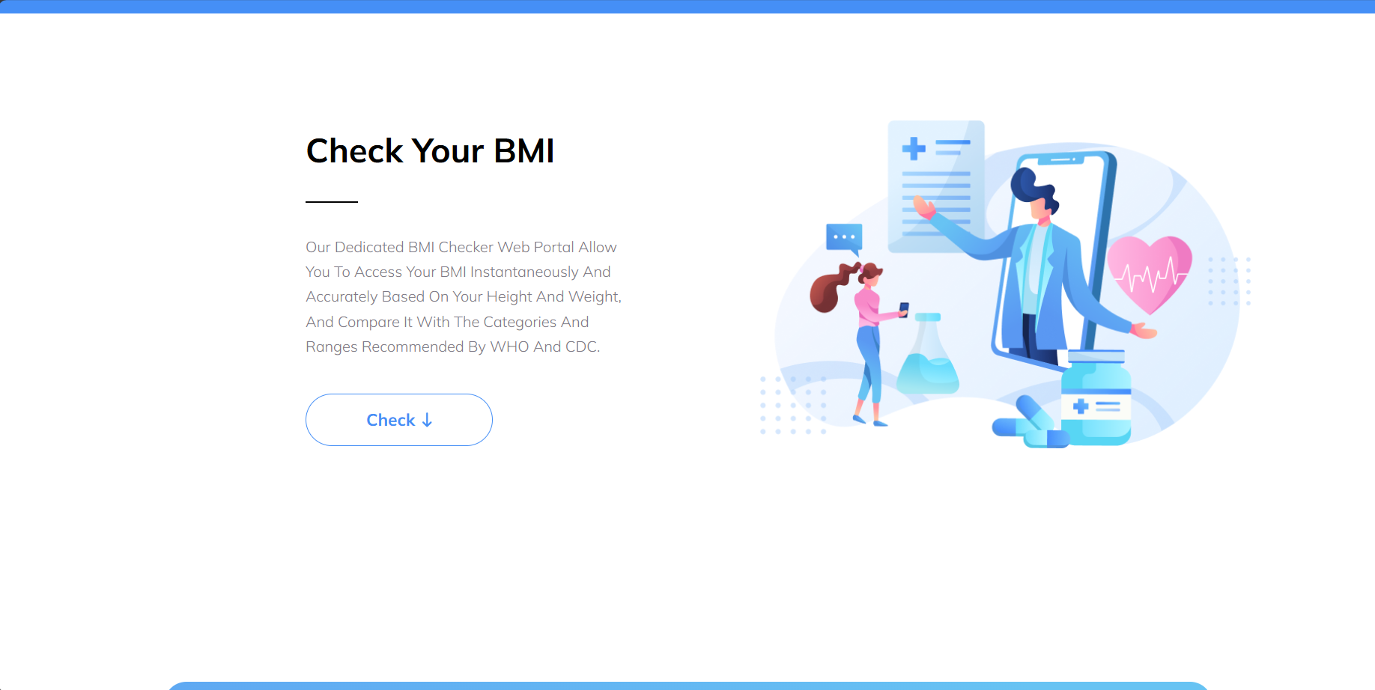


Slide 10

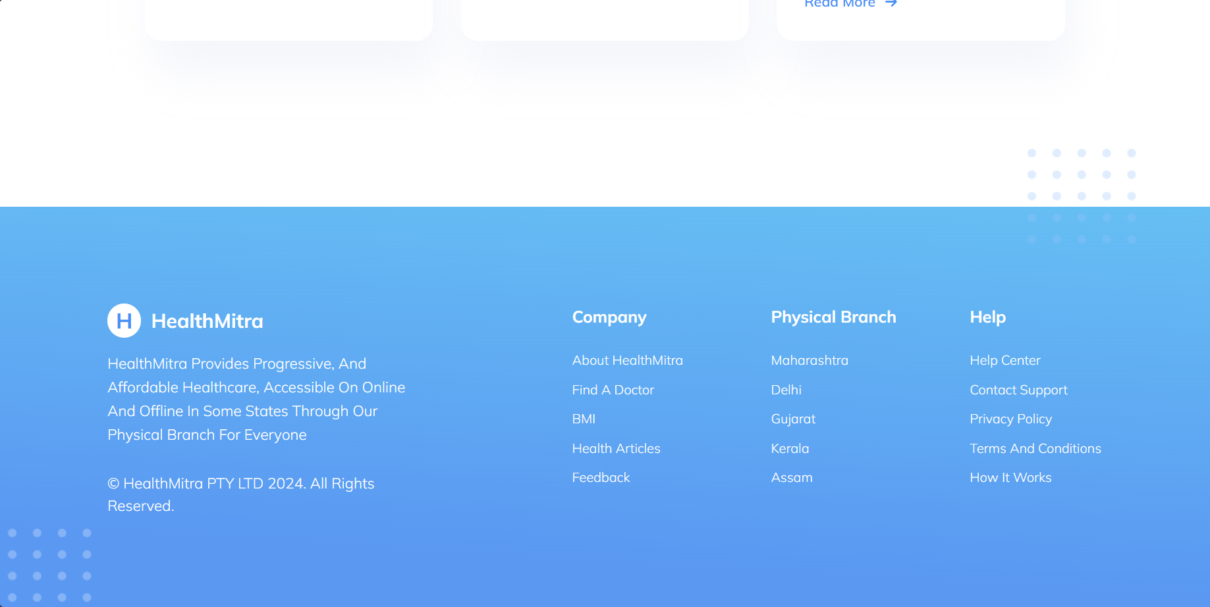

Slide 11
Applications:-
Applications: Our health advisor website with BMI calculator has numerous applications and benefits.
Key Features:
BMI Calculator: Calculate BMI accurately and receive instant results.
Personalized Health Advice: Receive tailored health recommendations based on BMI results.
Health Education: Access informative resources to enhance health knowledge.
Track Progress: Monitor changes in BMI over time and track progress towards health goals.

Slide 12
Conclusion:-
Conclusion: The health advisor website with BMI calculator is a valuable tool for promoting health awareness and empowering individuals to make informed decisions.
Key Takeaways:
Easy-to-use BMI calculator for accurate results.
Personalized health advice for tailored guidance.
Comprehensive health education resources for continuous learning.

Slide 13
References:-
Centers for Disease Control and Prevention (CDC). (2022). About Adult BMI.
World Health Organization (WHO). (2022). BMI Classification.
American Heart Association (AHA). (2022). Understanding BMI and Its Impact on Your Heart Health.
National Institutes of Health (NIH). (2022). Assessing Your Weight and Health Risk.
Harvard Health Publishing. (2022). Body Mass Index (BMI): What it is and why it matters.

Slide 14


